Slide 1
Capstone Project Results
-Mithun Thakkar

Slide 2
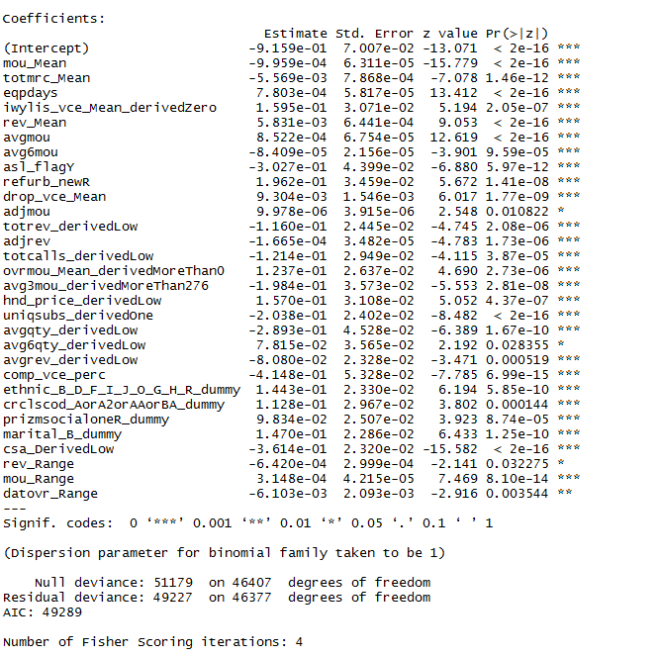
Factors driving likelihood of churn at Mobicom
Among them major factors being:
Percentage of completed voice calls to attempted voice calls
Communications local service area
Account spending limit
Average monthly number of calls over the life of the customer
Number of unique subscribers in the household

Slide 3



Cost and Billing is an important factor that influences churn

Slide 4

Network and service quality also influences churn

Slide 5
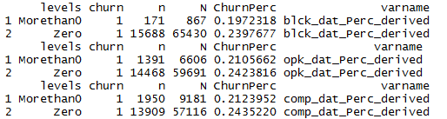
Data Usage Connectivity Issues are not turning out to be expensive

Slide 6
I would recommend rate plan migration as a proactive customer retention strategy

Slide 7
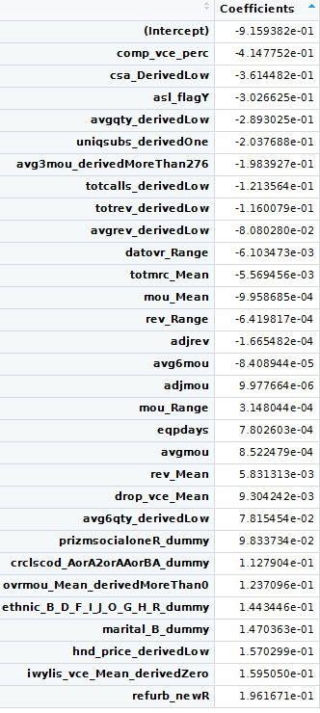
Usage of this churn model for prioritisation of customers for a proactive retention campaigns
Average monthly revenue over the life of the customer of less than 30 and between 42.74 and 77.18
Lower range of revenue of data overage
Lower mean total monthly recurring charge
Lower Mean number of monthly minutes of use
Lower Range of Revenue
Lower Billing adjusted revenue over life of customer
Lower MOU over previous 6 months
Higher Billing adjusted MOU over life of the customer
Higher range of number of minutes of use
Higher number of days of current equipment
Higher average monthly minutes of use over life of customer
Higher mean monthly revenue
Higher mean number of dropped voice calls
Average monthly number of calls over previous six months of less than 134
Social Group Rural
Credit class code of A,A2, AA or BA
Mean overage minutes of use of more than zero
Ethnicity roll-up code of B,D,F,I,J,O,G,H or R
Marital Code Inferred SIngle
Current Handset price of 10,30 or 40
Zero mean number of inbound wireless to wireless voice calls
Refurbished Handset
Prioritise customers with :
Lower Percentage of completed voice calls to attempted voice calls
Communications local service area where churn occurrence is more than 25%
Account spending limit
Average monthly number of calls over the life of the customer of between 29.46 and 1618
More than one unique subscribers in the household
Average monthly minutes of use over previous three months of less than 276
Total number of calls overs the life of the customer of between 1,018 and 6,639.

Slide 8

Target Segments for Proactive Retention Campaigns

Slide 9
Thank You

